Slide 1
AKSARAY UNIVERSITY

Slide 2
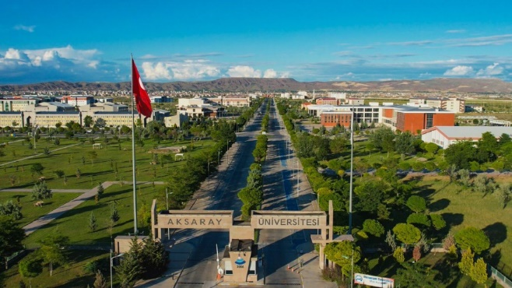
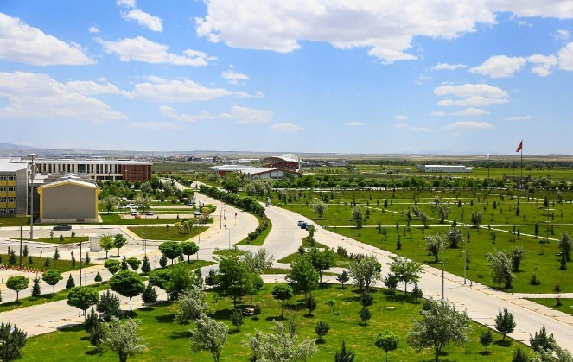
Aksaray University is a young university founded in 2006, yet it has a deep-rooted history; which dates back to 1986.
It started education as a Vocational School affiliated to Selcuk University. Aksaray University has
13 Faculties
6 Vocational Schools
3 Institutes
20 Research Centers

Slide 3
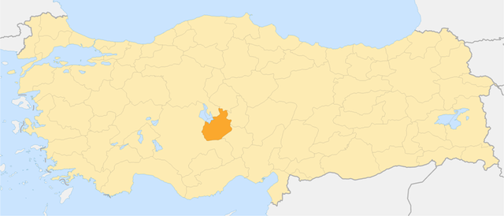
AKSARAY CITY
Aksaray is a city located in the Central Anatolian region of Turkey. It has a rich history that dates back to ancient times, and there are many interesting things to see and do in the city.

Slide 4
AKSARAY CITY
Aksaray has a long and fascinating history. It was originally settled by the Hittites, and later became an important center of the Seljuk Empire.
During the Ottoman Empire, Aksaray was also an important trading center (caravansary) and home to many notable scholars and artists.

Slide 5
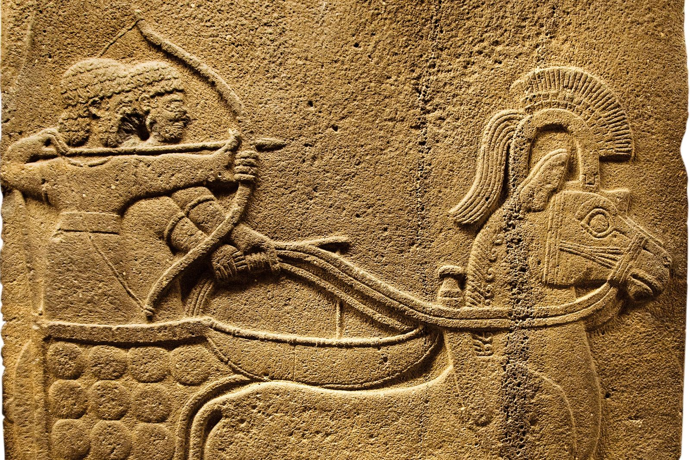
AKSARAY CITY
Ancient History: Aksaray has a long and rich history that dates back to ancient times. The region was first settled by the Hittites, who established a capital at Hattusa in the 17th century BC. Aksaray was also an important center of the Phrygian civilization, which flourished in the 8th-6th centuries BC.

Slide 6
AKSARAY CITY
Seljuk Empire: During the medieval period, Aksaray became an important center of the Seljuk Empire. Aksaray was one of their most important cities, and it played a key role in the empire's political and cultural life.

Slide 7
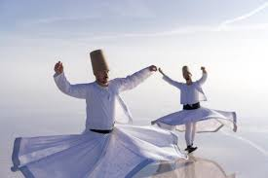
AKSARAY CITY
During the Ottoman Empire, Aksaray was an important trading center and home to many notable scholars and artists.
The city was also an important center of the Sufi order, and many important religious figures lived and taught there.

Slide 8
AKSARAY CITY
In the early 20th century, Aksaray became part of the newly-formed Turkish Republic.
The city underwent significant modernization and development during this period, with new infrastructure, schools, and businesses being established. Today,
Aksaray is a vibrant and growing city with a rich cultural heritage. It continues to be an important center of traditional crafts, and hosts many cultural events throughout the year.

Slide 9
AKSARAY CITY
Aksaray is home to many interesting landmarks and historical sites. One of the most famous is the Aşıklı Höyük archaeological site, which dates back to the Neolithic period. Other notable landmarks include the Aksaray Museum, the Sultan Han Caravanserai, and the Ulu Mosque.

Slide 10
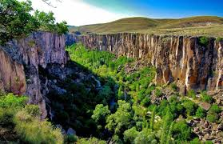
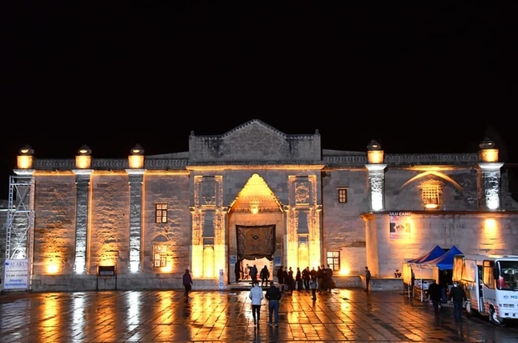
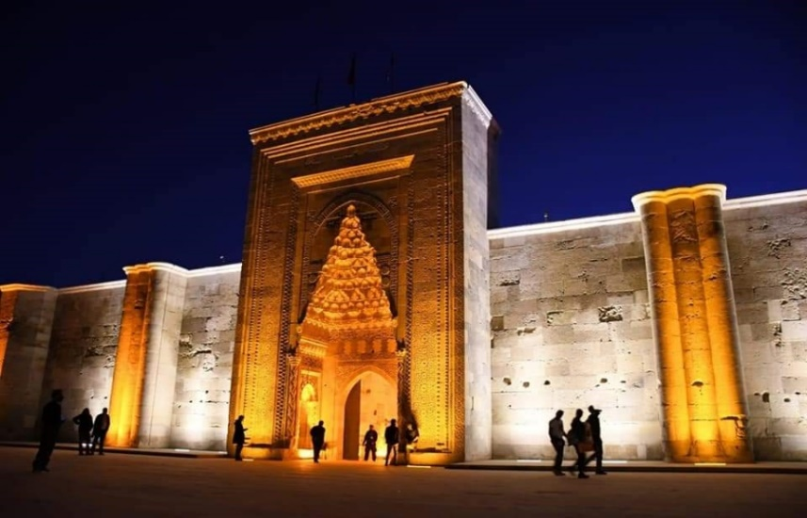
AKSARAY CITY

Slide 11
Aksaray University is a young university founded in 2006, yet it has a deep-rooted history; which dates back to 1986. It started education as a Vocational School affiliated to Selcuk University.

Slide 12
20850 students

Slide 13
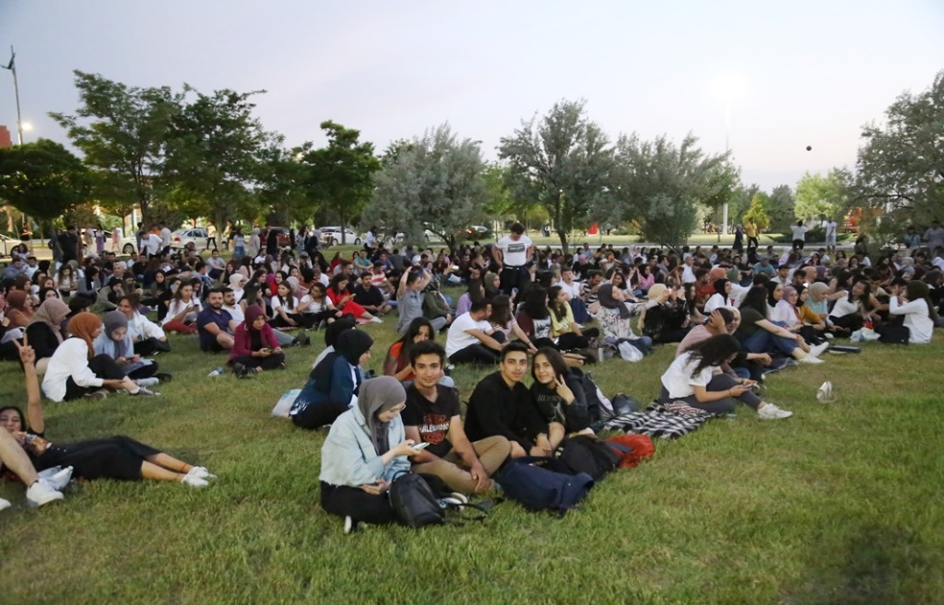
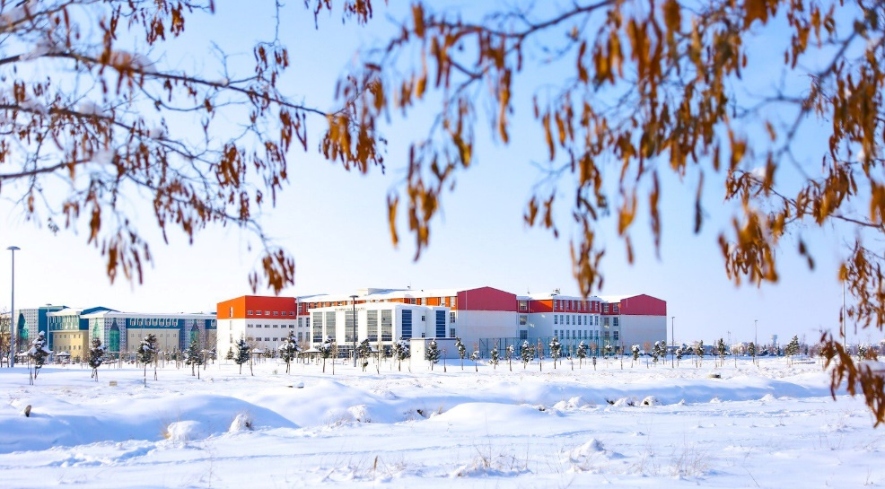
Numbers for students:
4670 – Associate Degree
11580 – Bachelor’s
2600 – Master’s and PhD

Slide 14
AGE | NUMBER
16-20 | 6100
21-25 | 9725
26-30 | 2674
31-35 | 1225
36-40 | 603
41-45 | 330
46-50 | 126
51-66 | 67

Slide 15
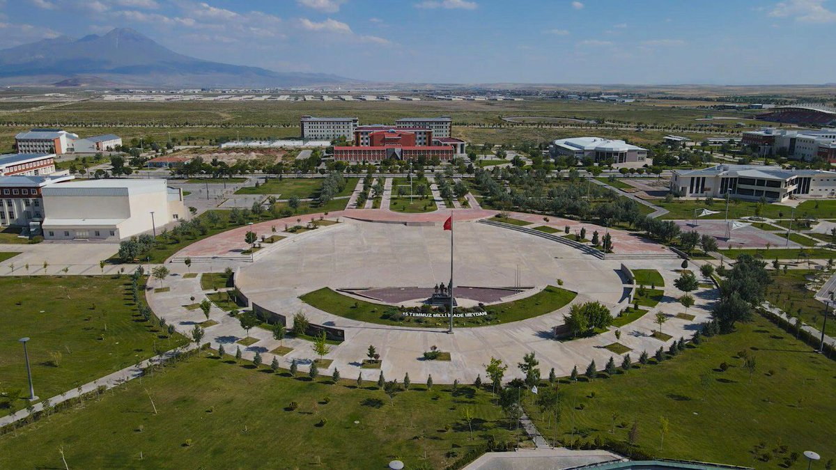
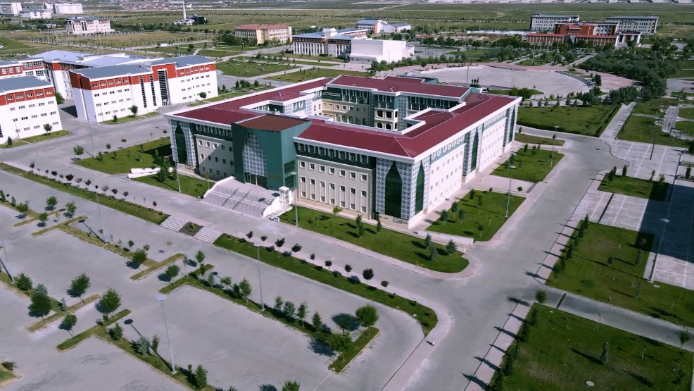
Aksaray University has
13 Faculties
6 Vocational Schools
3 Institutes
20 Research Centers

Slide 16
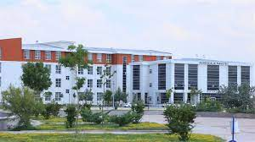
Faculties:
Medicine
Dentistry
Engineering
Architecture
Education
Health Sciences
Science and Letters

Slide 17
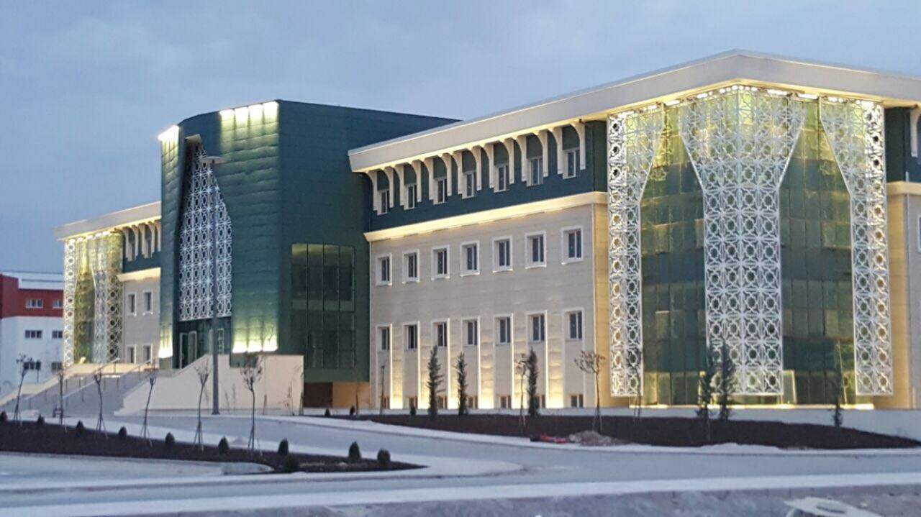
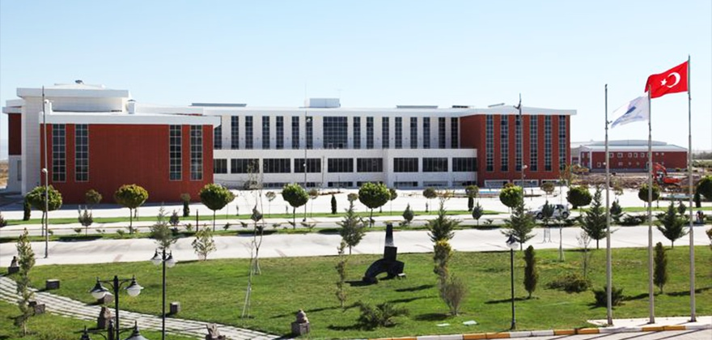
Faculties:
Adminstrative Sciences
Sport Sciences
Tourism
Veterinary
Communication
Islamic Sciences

Slide 18
Institutes:
Social Sciences
- 38 programs
Applied Sciences
- 41 programs
Health Sciences
- 22 programs

Slide 19
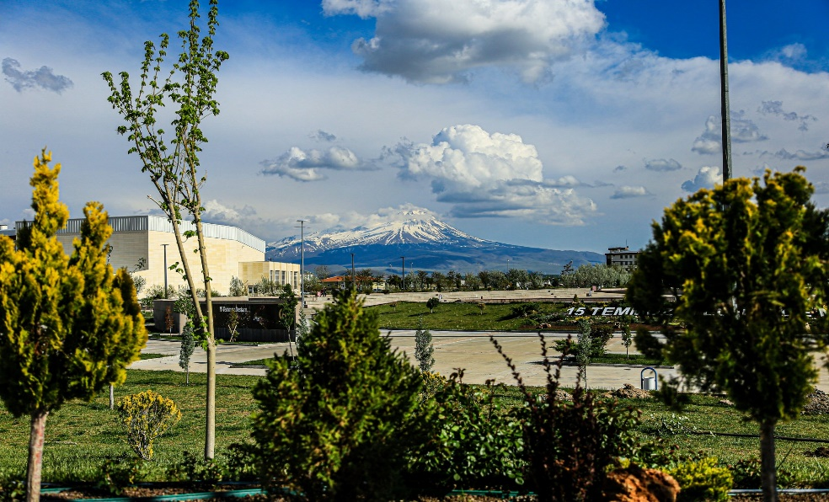
Numbers for students:
4161 – Associate Degree
12420 – Bachelor’s
2200 – Master’s and PhD
18781 - total

Slide 20
Numbers for staff: 118 – Professors
147 – Assoc. Prof.
249 – Asst, Prof.
198 – Lecturers
197 – Research Asst.

Slide 21
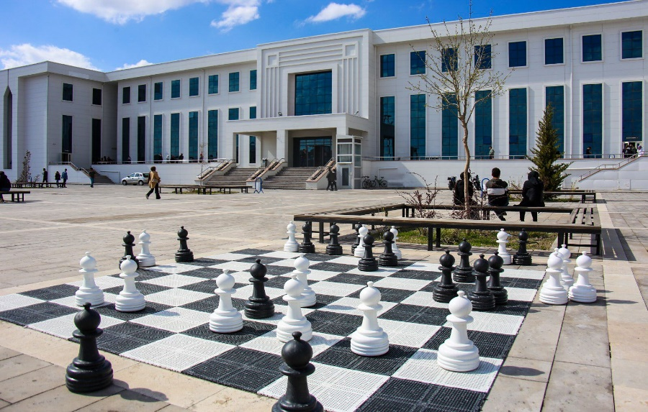
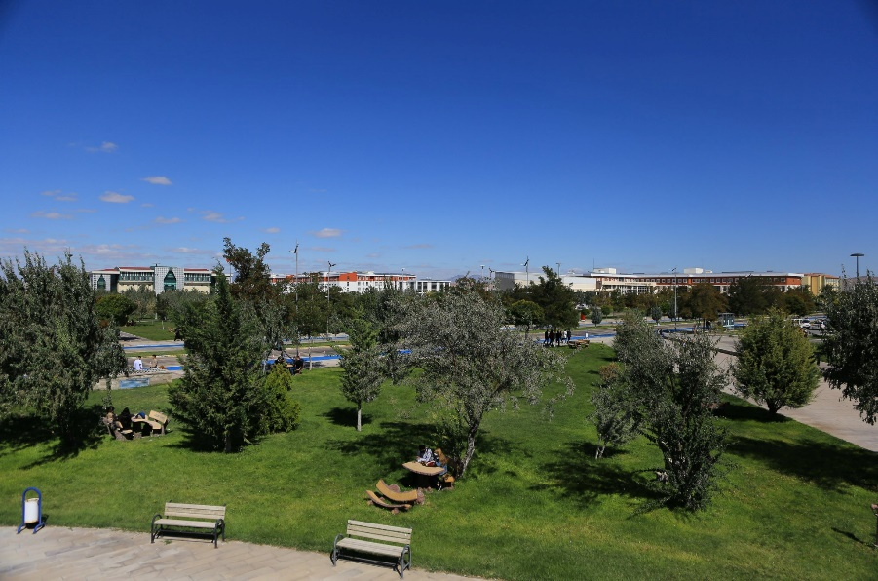
Some Statistics:
Number of Students per Academic Staff - 20.9
Rate of Graduate Students to Total Students - %13
2023 budget - 860mn ₺

Slide 22
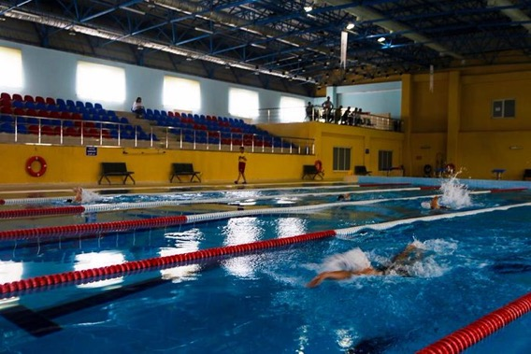
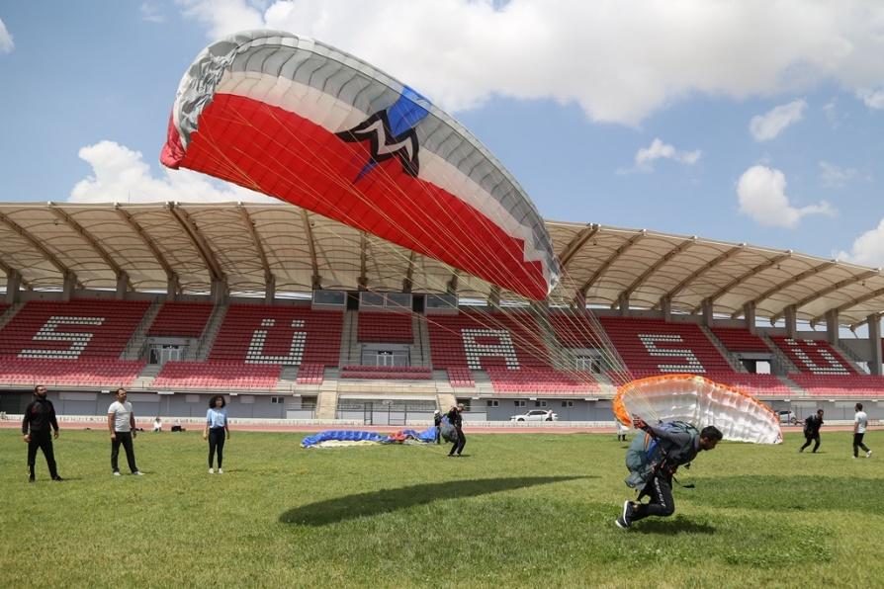
Specialization:
Aksaray University was determined as a pilot university in the field of "Sports and Health" within the scope of the "Regional Development-Oriented Mission Differentiation and Specialization Project" coordinated by the Council of Higher Education (YÖK) in 2018.

Slide 23
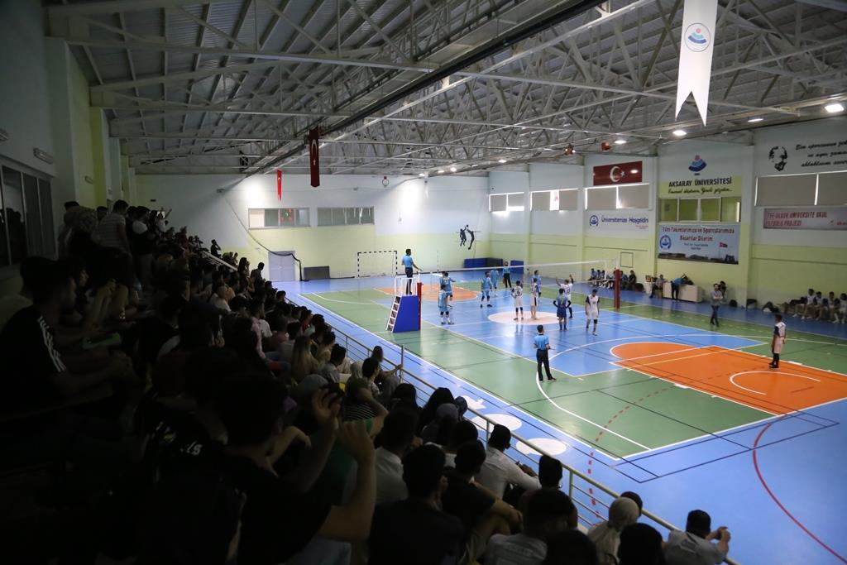
In this context, taking into account the needs and potential of the region and the university, Aksaray University's specialization in the field of Sports and Health and university-industry cooperation will be implemented and qualified human resources, innovation culture, investment and knowledge accumulation for value-added products will be provided to the region in this field.

Slide 24
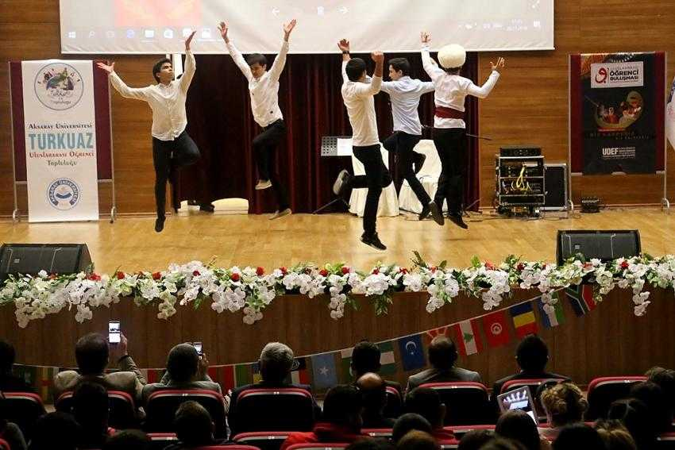
International Students:
149 Associate Degree
1352 Undergraduate
70 Master’s Degree
8 PhD Degree

Slide 25
International Students:
2018 – 1303
2019 – 1567
2020 – 1648
2021 – 1657
2022 – 2005

Slide 26
International Students: Top Countries
- Turkmenistan
Syria
Azerbaijan
Iraq
Somalia
Kazakhistan

Slide 27
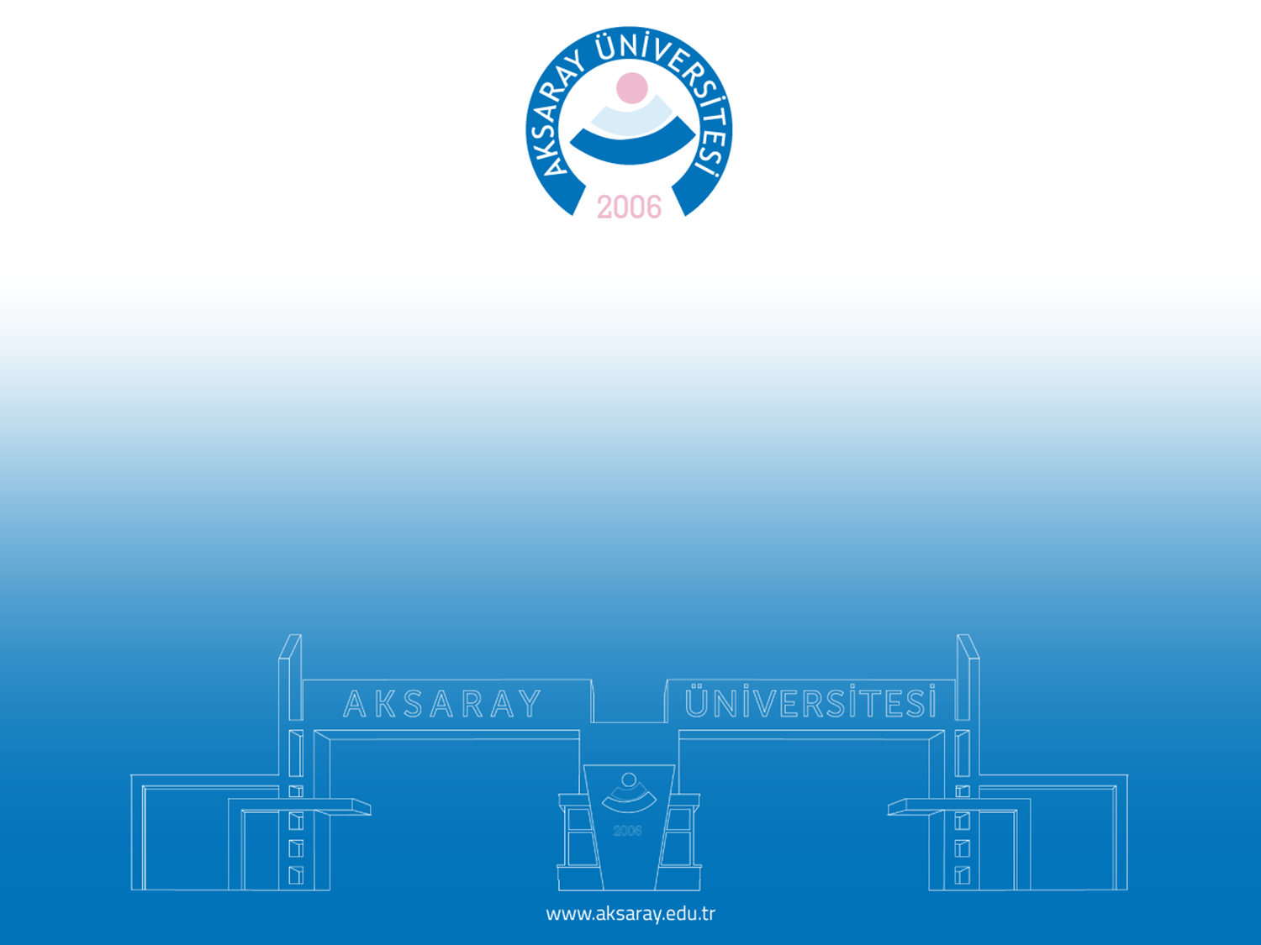
THANK YOU FOR YOUR ATTENTION
Lect Ugur Koyuncu
ugurkoyuncu@aksaray.edu.tr

